Slide 1


Deforestration Detection
Name:M.Devi Akshaya
Student Registration Id:STU681ccbda2eccc1746717658

Slide 2

Learning Objectives
Cleaned, transformed, and structured satellite-acquired deforestation data for analysis, gaining practical experience in real-world data preparation.
Built meaningful temporal and spatial features to identify patterns of deforestation over time.
Developed and optimized a Random Forest Classification model to detect deforestation regions with high accuracy.
Addressed data imbalance using SMOTE and RandomOverSampler techniques to ensure robust model performance.
GOAL
Source :
www.freepik.com/

Slide 3
Tools and Technology used
Python – Core language for data analysis and model development.
Pandas & NumPy – Data manipulation, cleaning, and temporal feature extraction.
Matplotlib & Seaborn – Visualization of forest cover trends and deforestation hotspots.
Scikit-learn – Machine learning modeling and hyperparameter tuning.
Imbalanced-learn (SMOTE) – Synthetic oversampling to balance minority (deforested) class.
Google Colab – Interactive coding and visualization platform.

Slide 4
Methodology
1.Inspected dataset for inconsistencies, missing values, and corrupt entries.
2.Extracted temporal features (year, month, day of week, hour) from acquisition timestamps.
3.Handled class imbalance using SMOTE and RandomOverSampler for robust classification.
4.Built Random Forest Classifier with hyperparameter tuning via RandomizedSearchCV.
5.Evaluated the model using metrics like precision, recall, accuracy, and confusion matrix.

Slide 5
Problem Statement:
Given satellite imagery metadata and temporal data (such as fire classification, forest cover percentage, acquisition date, acquisition time), develop a machine learning model to classify whether a given region is undergoing deforestation. Address the challenges of imbalanced datasets where deforestation instances are rare compared to non-deforestation cases.

Slide 6
Solution:
Using a machine learning classification model (Random Forest), the system identifies patterns in satellite data to classify regions as deforested or not. SMOTE and RandomOverSampler addressed dataset imbalance,
ensuring the model doesn’t overlook rare deforestation instances. The result is a reliable and efficient model
capable of providing early warnings about deforestation trends.
Git hub link:https://github.com/DeviAkshaya/AICTE-internship.git
Google colab link:https://colab.research.google.com/drive/1DB4kv_DJwX-JDXcOv-G_-0_ioZ8qqp3g#scrollTo=
mksENJpTLO30

Slide 7
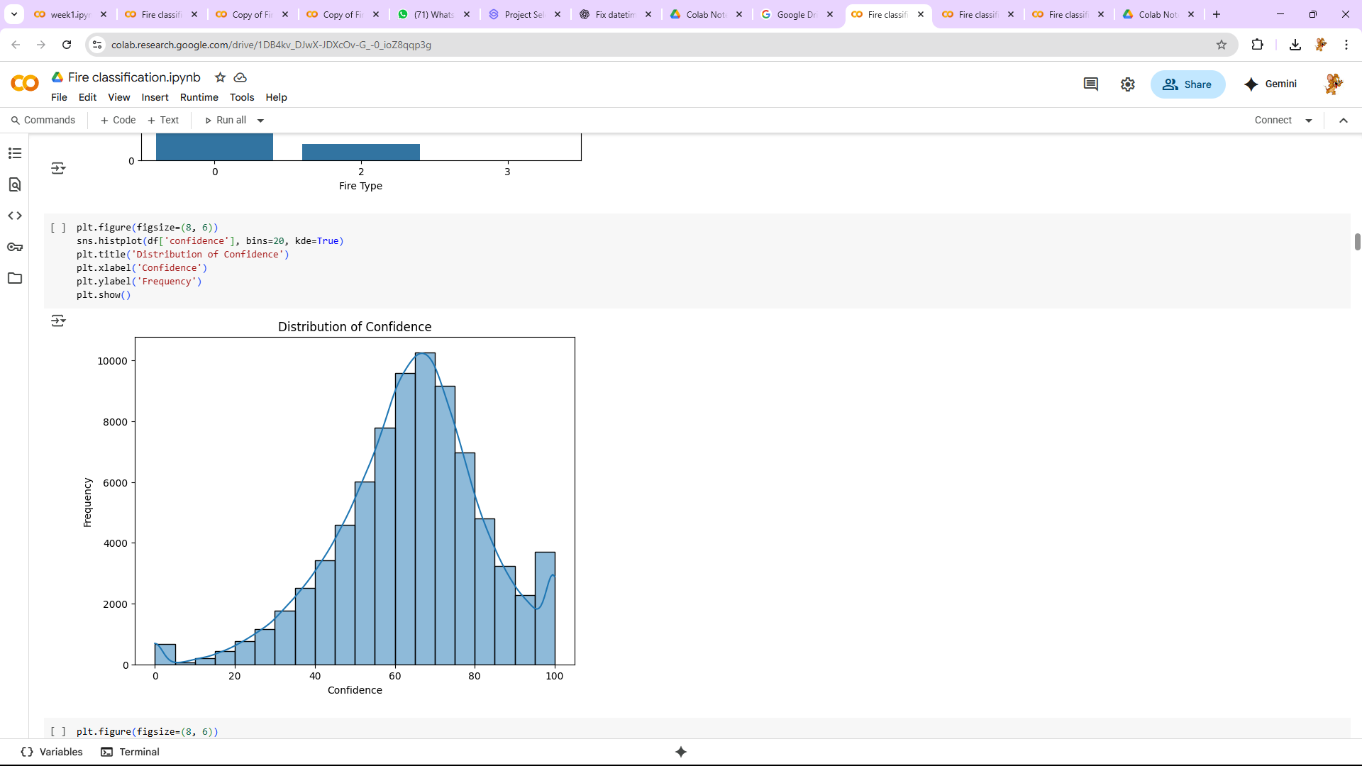
Screenshot of Output:

Slide 8
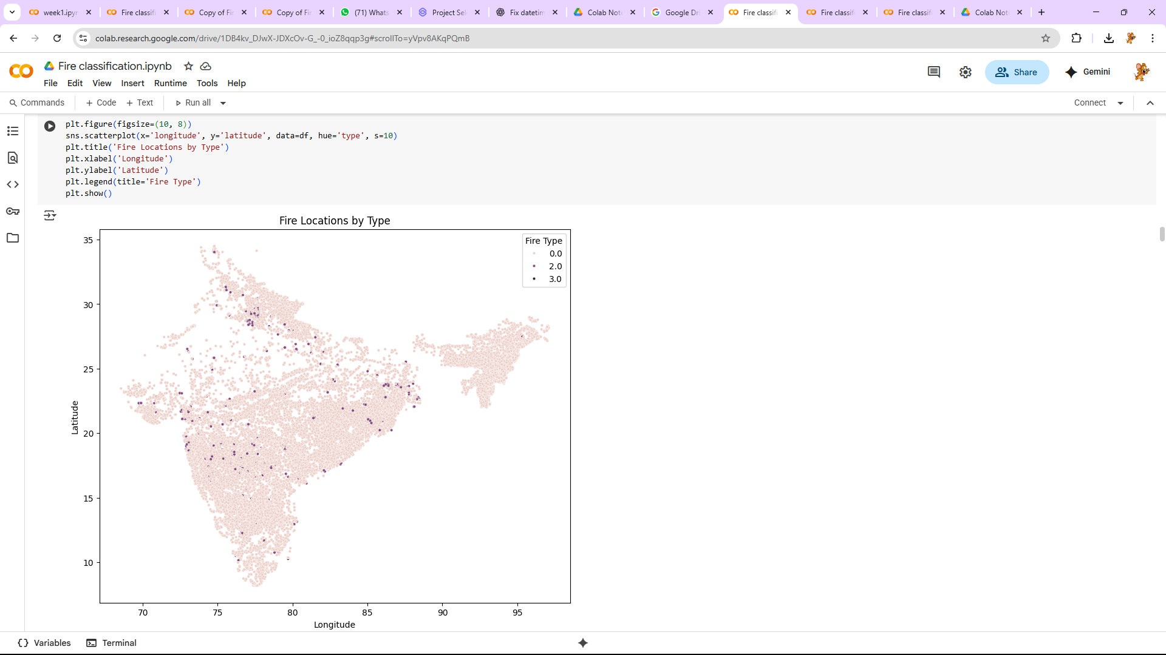
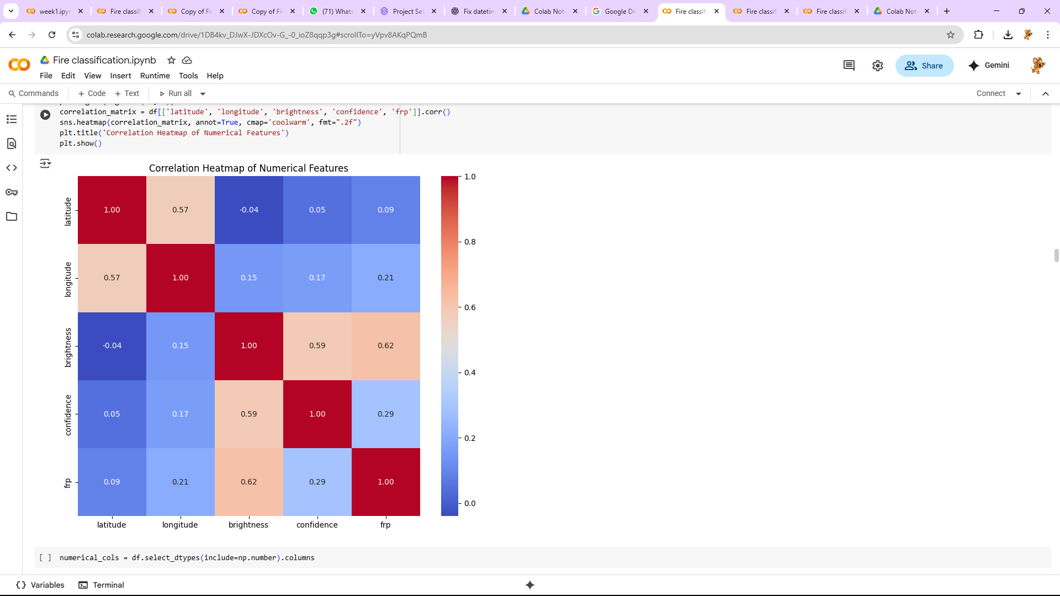
Screenshot of Output:

Slide 9
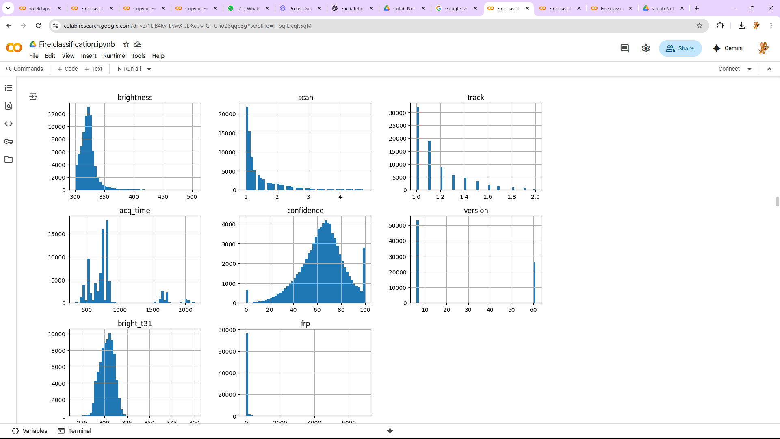
Screenshot of Output:

Slide 10
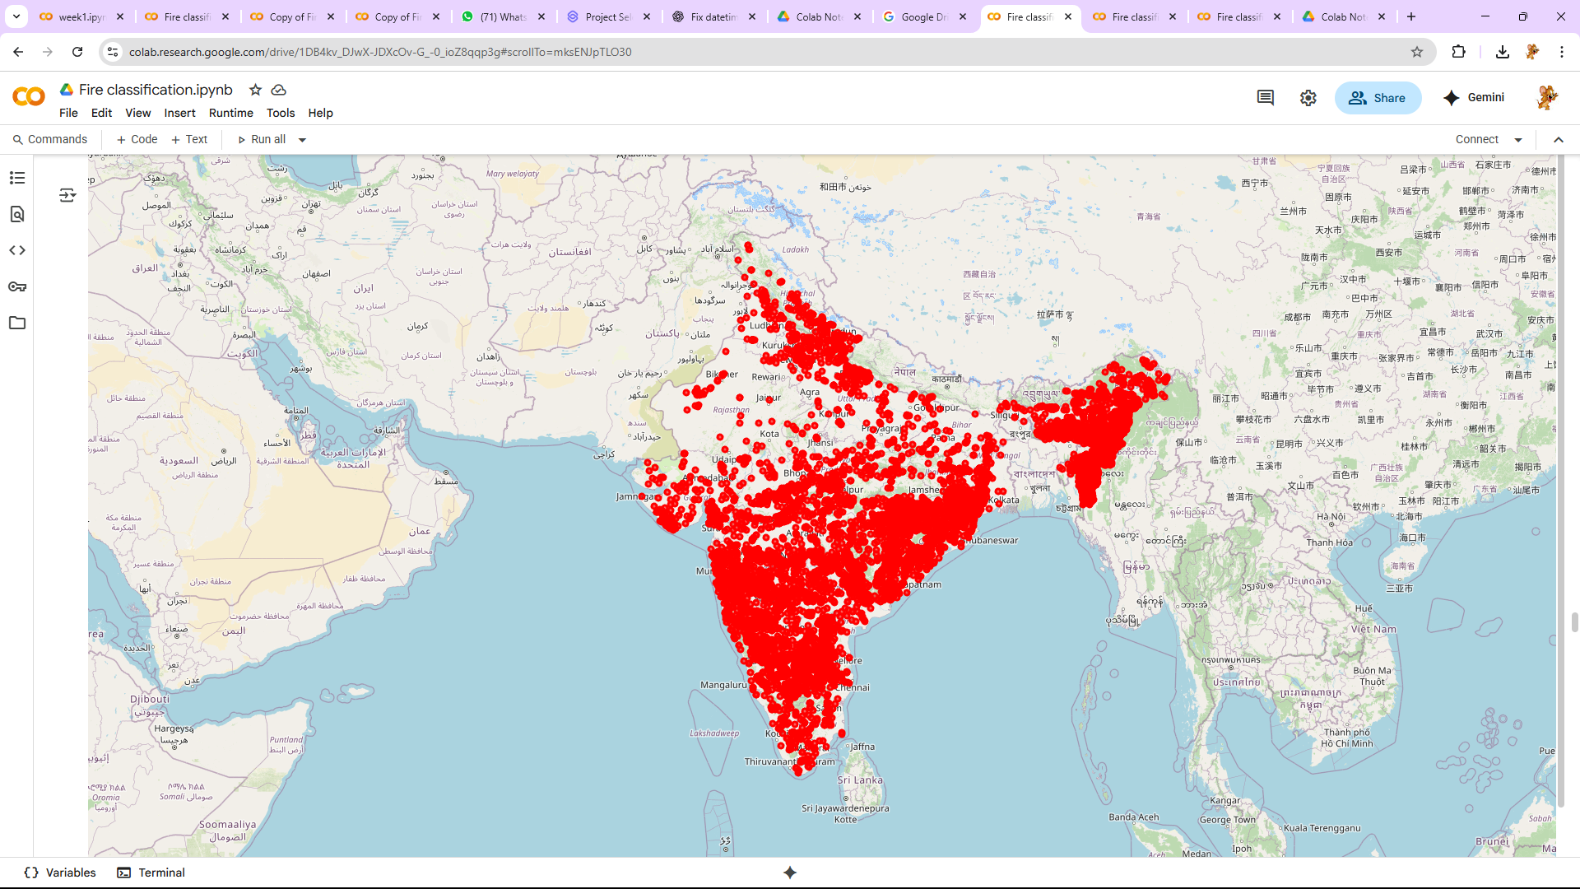
Screenshot of Output:

Slide 11
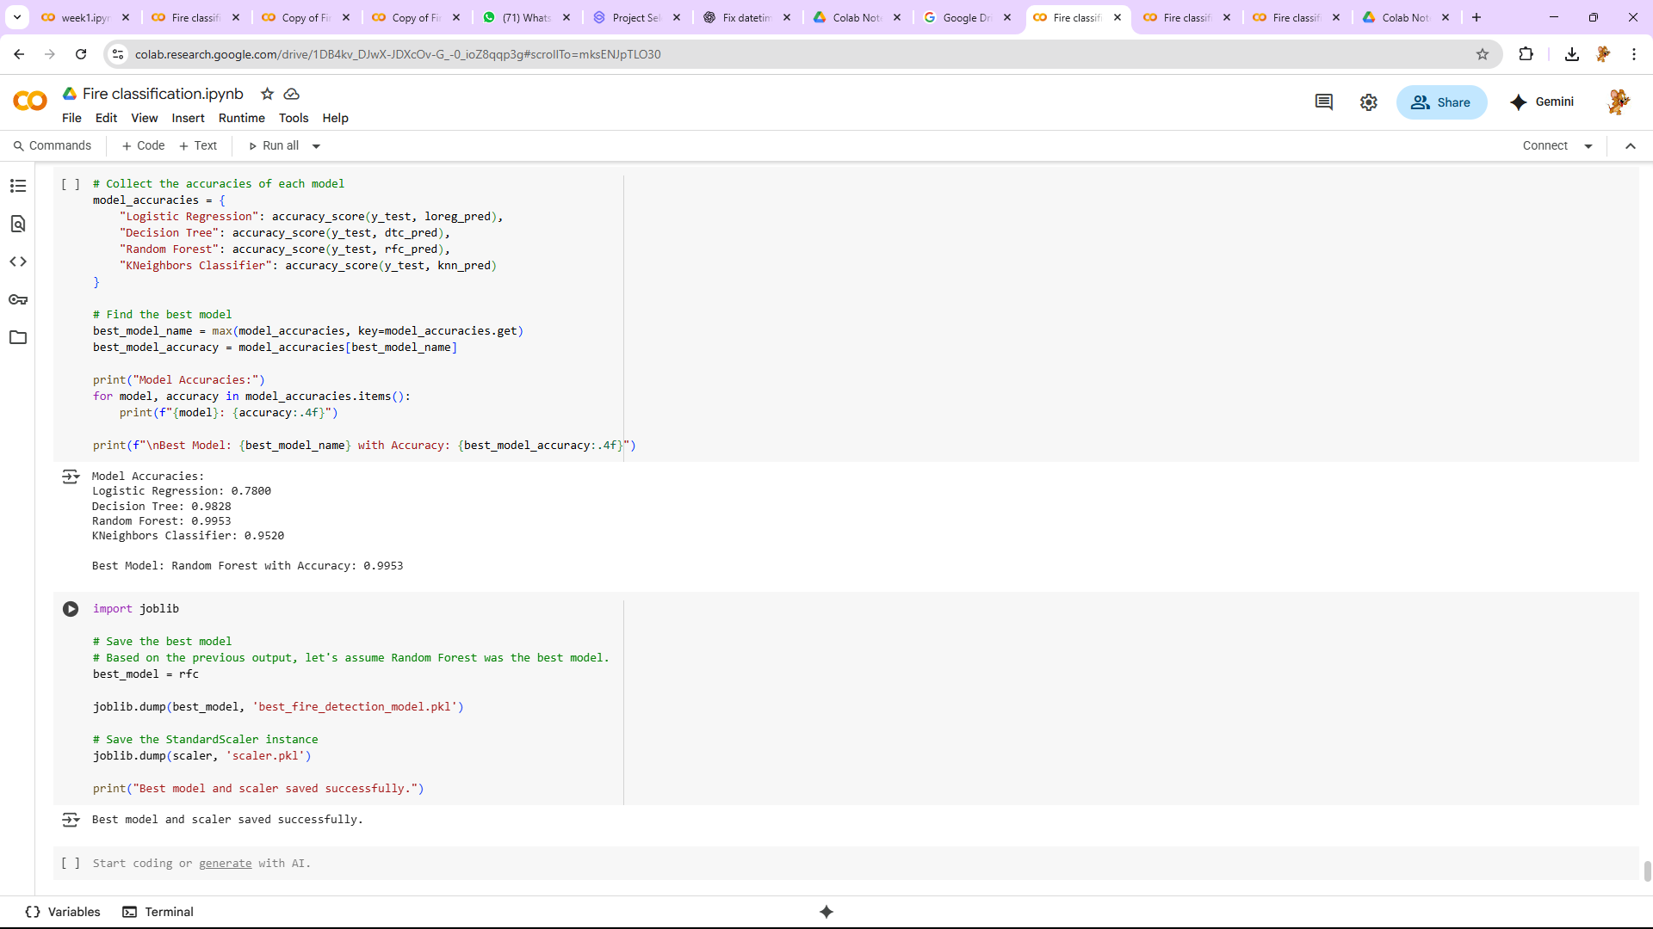
Screenshot of Output:

Slide 12
Conclusion:
The project successfully utilized machine learning techniques to detect deforestation patterns with enhanced accuracy, despite class imbalance challenges. The combination of temporal feature engineering, SMOTE
oversampling, and Random Forest modeling allowed the system to generalize well on unseen data, proving
its potential for real-world environmental monitoring applications.

